Slide 1
Work Packages
1. Simulation framework
A. Flight Dynamics imported to Unreal
- Could be low fidelity,e.g. limited axes, or 3rd part Flight model integration. It could be fixed/rotary wing (min.3 Drone)
B. Scenario template in Unreal
- Geographic/relative position of targets (e.g., Points A-B, no-flight zones, 3D trajectories, etc.)
C. Integration with Trajectory algorithms
- If formulating the ‘optimization problem’ and the representation of the simulation framework is not possible, use Unreal to provide trajectory results
2. Trajectory
A. Defining Multi-drone trajectory algorithms
- Literature survey on algorithm methods for swarm/multiple drone applications
B. Implementation of the chosen trajectory algorithms
- Embed the trajectory algorithms to the solution
C. Interaction with HMI
- Selected algorithm parameters could be altered
3. HMI (Human Machine Interface)
A. Definition of controlling methods of multipe drones
- what you control, what you observe and react, what they report back, level of authority
B. Implementation of HMI methods
- Unreal user interface dev. [ could be minimal ]
Visualization
A. Linking to Asgard for visualization
- Implement the solution to be integrated in Asgard view.

Slide 2
Simulation framework
Trajectory
HMI
Visualization
Sept
Oct
Nov
Dec
Jan
Feb
Mar
Vac.
WP1
Link WP1
WR
WR
WP2
Link WP2
WP3
WP4

Slide 3


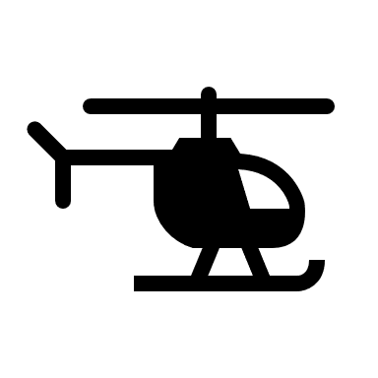
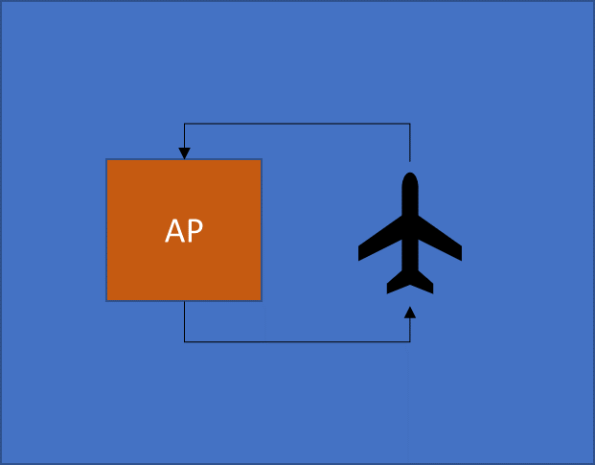
05.09.22
1. Simulation framework
A. Flight Dynamics imported to Unreal
A nonlinear fixed wing (airplane) with outer loop controls :
1) Heading
2) Height
3) Speed
Entity 1
Entity 2
1) Heading
2) Height
3) Speed
Inner-loop dynamics
AP
AP
PID autopilot
Inner-loop dynamics

Slide 4
05.09.22
1. Simulation framework
A. Flight Dynamics imported to Unreal
A nonlinear fixed wing (airplane) with outer loop controls :
DY : Check with MTL UAV modeling experts
KL : 1] Exploring more entity (Flight model+AP) -> could be quadrotor, rotorcraft, fast jet, etc.
KL : 2] Check with Traj. Opt. guys for flight dynamic+AP (i.e., entity) dynamics preferences.
KL : 3] Sample scenario with position command to 3 entities in Unreal env.
Position

